Slide 1

AI Agents in Excel and Copilot Studio
George Mount
Stringfest Analytics

Slide 2
Objectives For Today
Integrate and execute Agent Mode in Excel to build analytical and reporting tools and workflows.
Design and deploy lightweight agents in Copilot Studio to perform repetitive data analysis tasks.
Demonstrate how agentic AI can extend across Microsoft 365 tools such as Power BI and Teams.
Apply best practices for guiding and supervising AI agents to ensure data accuracy and compliance.
Notes:
Today’s session has four main objectives, and I want to set expectations clearly from the start.
**First**, we’ll look at how Agent Mode in Excel actually works in practice. Not as a theoretical feature, but as something you can use to build repeatable analytical and reporting workflows inside the tools you already use every day. I want you to see how lightweight and approachable this is—even if you don't consider yourself a “developer.”
**Second**, we’ll move into **Copilot Studio** and design a small, task-focused agent together. The idea is not to build a giant, all-knowing system. Instead, we keep it tight and purposeful so it solves a specific analysis problem reliably. That’s the sweet spot for most business use cases right now.
**Third**, I’ll show how these agents don’t just live inside Excel. The same building blocks extend across Microsoft 365—Power BI, Teams, and more. You’ll see how this becomes a cross-tool workflow rather than a one-off automation.
**Finally**, we’ll talk about supervision and guardrails. Agents are powerful, but they still require human oversight. I’ll walk you through practical techniques for guiding, correcting, and validating their output so you maintain accuracy, governance, and compliance—without slowing yourself down.
The whole session is about making “agentic AI” real, accessible, and useful for your day-to-day analytical work.

Slide 3
Schedule For Today
Module 1: Agent Mode and Pre-Built Agents
Module 2: Build an Excel Chatbot in Copilot Studio
Module 3: Building and Deploying an Automated AI Workflow
Notes:
This is how we’re structuring the session so you know exactly where we’re headed.
Module 1 is all about grounding you in Agent Mode inside Excel. We’ll look at what’s already available out of the box, the types of tasks these pre-built agents can handle, and where they fit into analytical workflows. This gives you a sense of the “building blocks” before we create anything ourselves.
Module 2 is where we shift into Copilot Studio and actually build an Excel-aware chatbot together. It won’t be a massive, enterprise chatbot—just a focused, purpose-built one that helps with a specific data task. This is intentional—lightweight agents are where the biggest wins are right now.
Module 3 is where we connect everything. We’ll take what we built and wrap it into a small, automated AI workflow—something that could realistically run inside your team or department today. You’ll see how these pieces fit together across Excel, Copilot Studio, and the broader Microsoft 365 ecosystem.
By the end you’ll see a full, end-to-end path: from using built-in agents → to building your own → to deploying something that actually works in the real world.

Slide 4

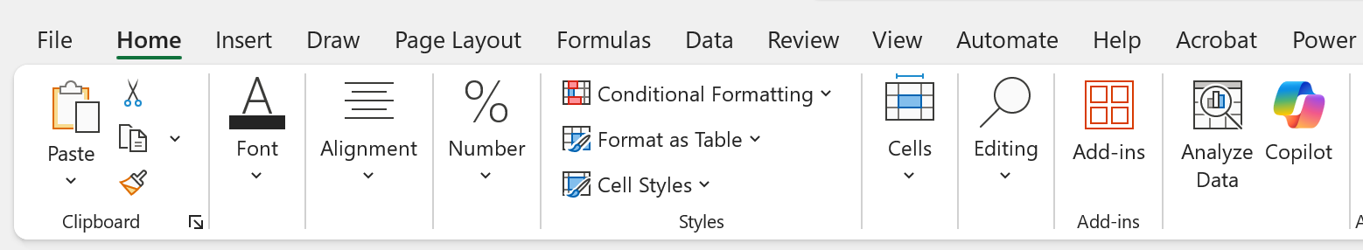
Pulse Check
Do you have access to Copilot in Excel?
Home > Copilot

Slide 5
Pulse Check
Do you have access to Agent Mode in Excel Online?
Available via the Frontier program: https://adoption.microsoft.com/en-us/copilot/frontier-program/

Slide 6
Pulse Check
Do you have access to Copilot Studio?
Free trial available: https://learn.microsoft.com/en-us/microsoft-copilot-studio/requirements-licensing-subscriptions

Slide 7
I. Agent Mode and Pre-Built Agents
What Excel features does Python in Excel depend on?
Formulas
PivotTables
Power Query
Copilot
Data Remember when Excel got…
Now it’s getting Agents!
Notes:
When we look back at Excel’s history, you can see these clear jumps in capability. Each one changed what analysts could do without leaving the tool. Formulas gave people real calculation power. PivotTables took that further with fast summarization and reporting. Power Query opened the door to repeatable data cleaning and transformation. And then Copilot arrived and added natural language on top of all of that. Each step expanded what “Excel work” could mean.
And now we’re at the next step. AI agents aren’t just another feature. They represent a shift from you doing the work inside Excel to Excel coordinating work for you across tools, data, and processes. This is the same kind of leap we saw when Power Query arrived, but bigger. It means we can start automating decisions, workflows, and tasks that used to take multiple systems and a lot of manual effort. Today I’ll show you what that looks like in practice and how Excel users can take advantage of it right now.

Slide 8
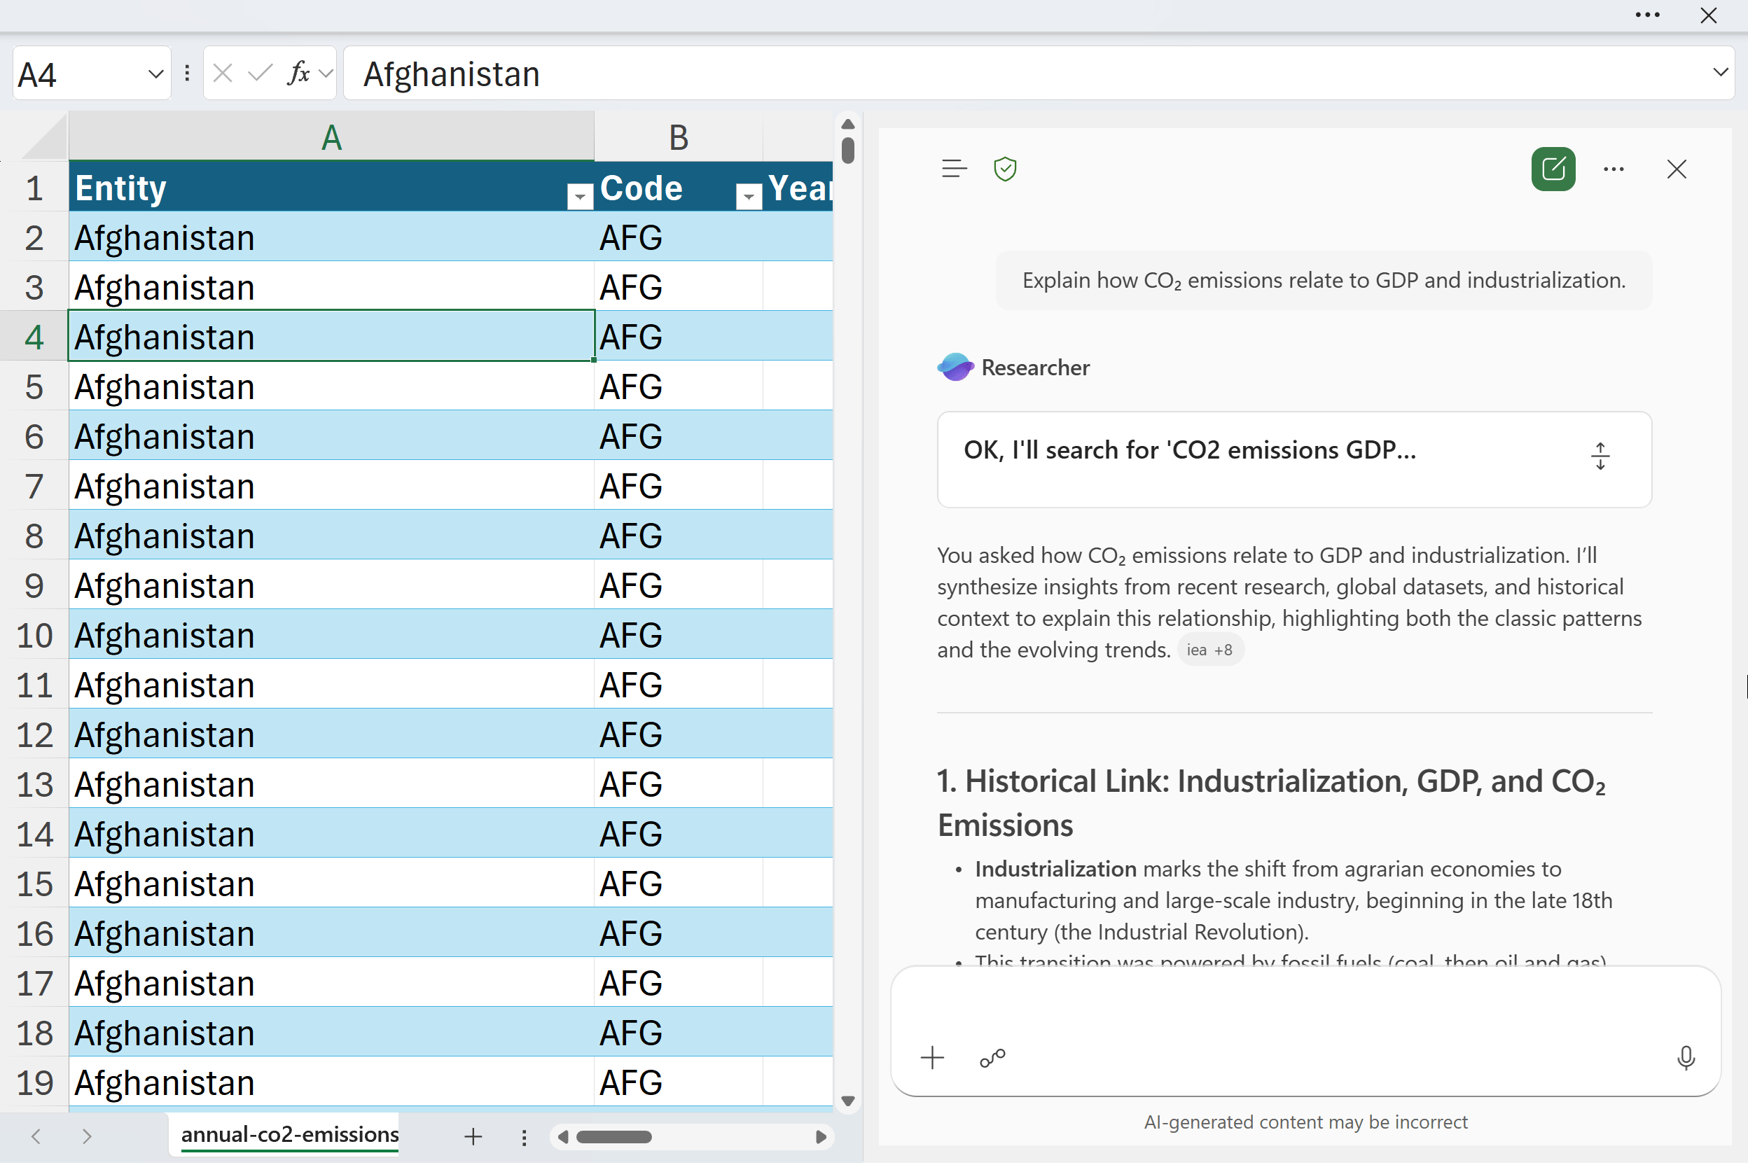
Demo
Using the Researcher & Analyst agents in Excel
Dataset: researcher-analyst.xlsx
Researcher helps you understand the broader context around your data.
Analyst performs calculations and generates insights directly from your tables.
Together they show Excel’s shift from simple prompts to agent-driven reasoning.
Notes:
For this demo, we’re going to use a simple workbook called researcher-analyst.xlsx. The dataset itself isn’t complicated—that’s intentional. What I want you to focus on is how the two built-in agents behave and what they’re each good at.
First, we’ll look at the Researcher agent. This one is designed to give you context—bigger-picture explanations, trends, and background knowledge you’d normally have to search for manually. Think of it as the “why” behind the data.
Next, we’ll switch to the Analyst agent. This one is much more grounded in your actual tables. It runs calculations, pulls patterns directly from the sheet, and produces insights tied to the numbers in front of you. It’s the “show me what’s happening in my data” piece.
When you use them together, you start to see how Excel is shifting from single-shot prompts toward real agent-driven reasoning. One agent frames the context, the other generates measurable outputs, and you get a much more complete picture with far less effort.
The goal here isn’t to memorize features—it's to see the workflow: context → analysis → action. That’s the paradigm Microsoft is moving toward, and you’ll use the same pattern when we build our own agents later in the session.

Slide 9
What does Microsoft mean by “agent?”
An agent is an AI system that can understand goals, reason about steps, and take actions to complete a task.
Goes beyond Q&A → performs multi-step workflows driven by user intent.
Uses memory, tools, and environment signals to stay on track.
Designed to be autonomous but bounded (rules, safety, context).
Notes:
When Microsoft uses the word “agent,” they’re talking about something more advanced than a normal chatbot. An agent is meant to understand a goal, break it down into steps, and then take actions to complete those steps. So instead of you asking a quick question and getting an answer, an agent can actually carry out a workflow on your behalf.
It can use memory, tools, and signals from its environment to stay oriented. That means it doesn’t lose the thread every time you ask something new. It can keep track of what you’re trying to accomplish and move the task forward.
Microsoft also emphasizes that agents are autonomous but still bounded. They operate inside rules, safety constraints, and context so they can take initiative without running off and doing unpredictable things. This is the shift we’re stepping into: Excel isn’t just giving you answers, it’s starting to *do work* for you.

Slide 10
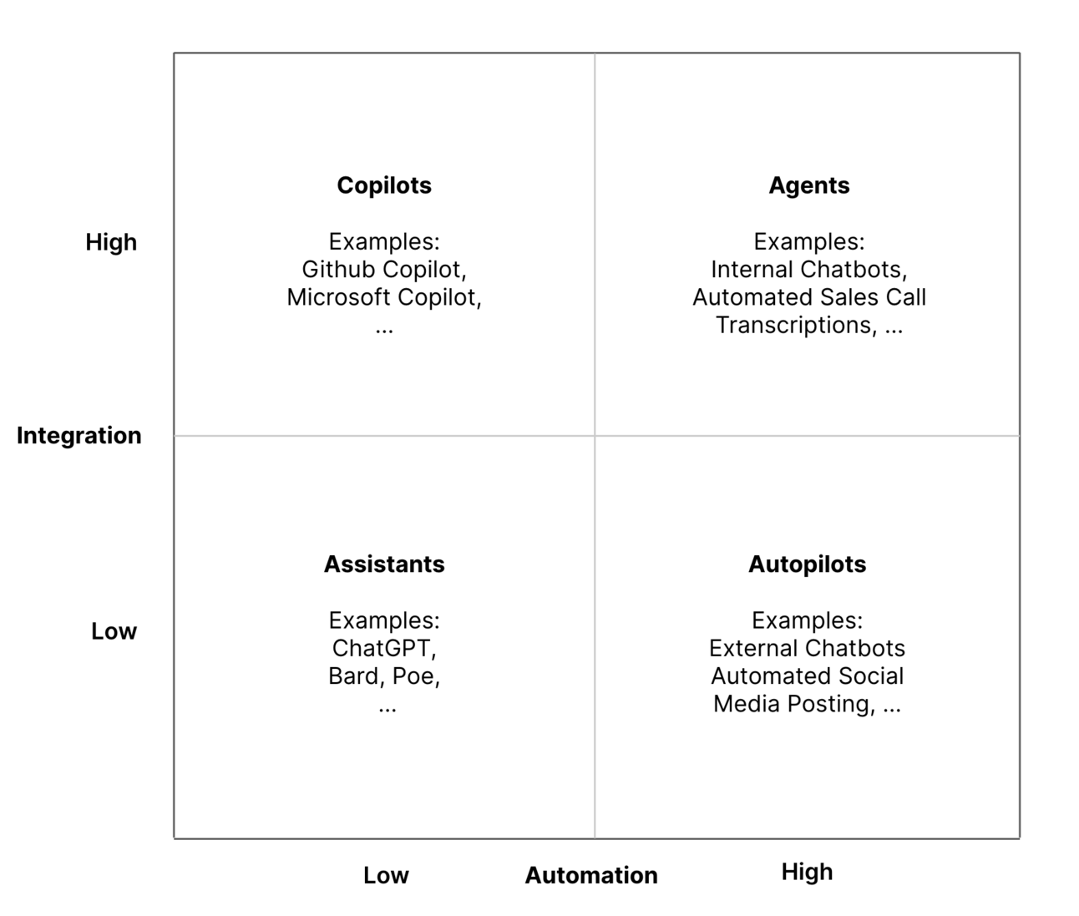
The integration-automation AI framework
Source: https://blog.tobiaszwingmann.com/p/integration-automation-ai-framework
Notes:
This framework helps make sense of all the vocabulary we’ve been talking about. Instead of treating “copilots” and “agents” as fuzzy marketing terms, it breaks things down by two dimensions: how integrated the tool is with your systems, and how much automation it can actually perform.
In the top left, you have copilots. They’re highly integrated because they sit inside your existing apps, but they still rely on you to drive the workflow. They improve your work, but they don’t take it over.
On the right, you have agents. They combine that same level of integration with the ability to take multi-step actions on their own. So they’re not just responding to you, they’re actually completing tasks across systems.
Below that, you have assistants and autopilots. These are less connected to your internal data and tools, even if some of them can automate quite a bit.
The main idea here is that Excel is moving from the “copilot” box toward the “agent” box. That’s why everything suddenly feels like it’s changing. It isn’t just giving you answers anymore — it’s starting to orchestrate real work.

Slide 11
The integration-automation AI framework
Source: https://blog.tobiaszwingmann.com/p/integration-automation-ai-framework
Notes:
This framework helps make sense of all the vocabulary we’ve been talking about. Instead of treating “copilots” and “agents” as fuzzy marketing terms, it breaks things down by two dimensions: how integrated the tool is with your systems, and how much automation it can actually perform.
In the top left, you have copilots. They’re highly integrated because they sit inside your existing apps, but they still rely on you to drive the workflow. They improve your work, but they don’t take it over.
On the right, you have agents. They combine that same level of integration with the ability to take multi-step actions on their own. So they’re not just responding to you, they’re actually completing tasks across systems.
Below that, you have assistants and autopilots. These are less connected to your internal data and tools, even if some of them can automate quite a bit.
The main idea here is that Excel is moving from the “copilot” box toward the “agent” box. That’s why everything suddenly feels like it’s changing. It isn’t just giving you answers anymore — it’s starting to orchestrate real work.

Slide 12
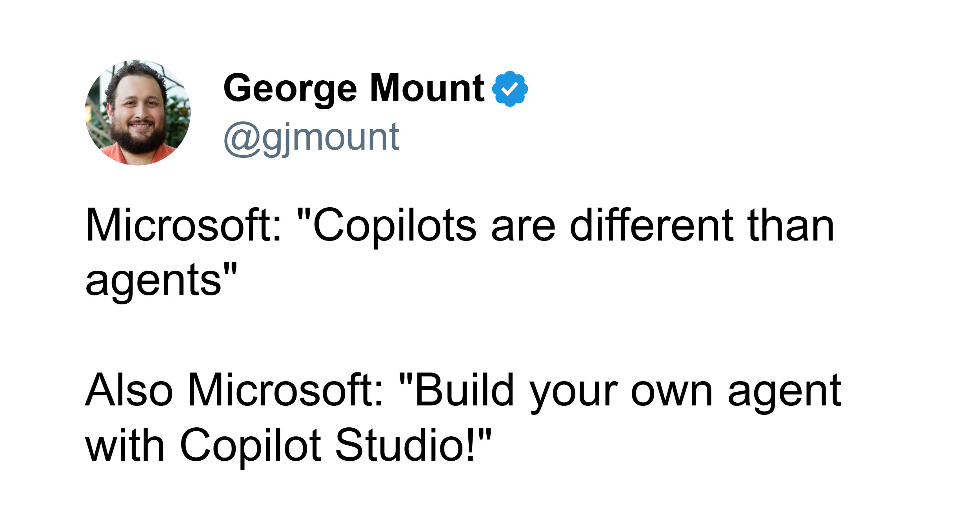
The lines are sometimes not so clear…
Notes:
MSFT draws a distinction between copilots and agents, but in practice the language gets blurry. Copilots are supposed to help you inside an app, while agents are supposed to run multi-step tasks across apps. But then you open Copilot Studio and the first thing it tells you is that you can build your own “agent,” even though it’s branded as a copilot.
So part of what we’re doing today is cutting through that. The terminology is evolving, the marketing messages don’t always line up, and honestly even Microsoft mixes the words. What matters for us is understanding what these tools can actually do: follow goals, take actions, and complete work that used to take you a lot of manual effort. The names will shift, but the capability is what’s important.

Slide 13
Discussion
Have you tried Copilot in Excel? What have you liked and disliked about it?
Where could Excel benefit you further with agentic assistance?
Notes:
For this part, I want to open things up and hear from you. Copilot in Excel has been out long enough that most people have at least tried it once or twice. I’m curious what your experience has been so far. What worked well for you, and what didn’t land? There’s no right answer here — every team uses Excel differently, so your feedback helps shape the rest of the session.
The second question is about possibilities. Based on the work you do every day, where do you see Excel needing more help? Think about the repetitive tasks, the handoffs, the manual steps that always break, or the places where you wish Excel could just take something off your plate. Those are the kinds of scenarios where agent-style assistance can really shine. The more examples you share, the easier it is to connect today’s concepts to your real workflow.

Slide 14
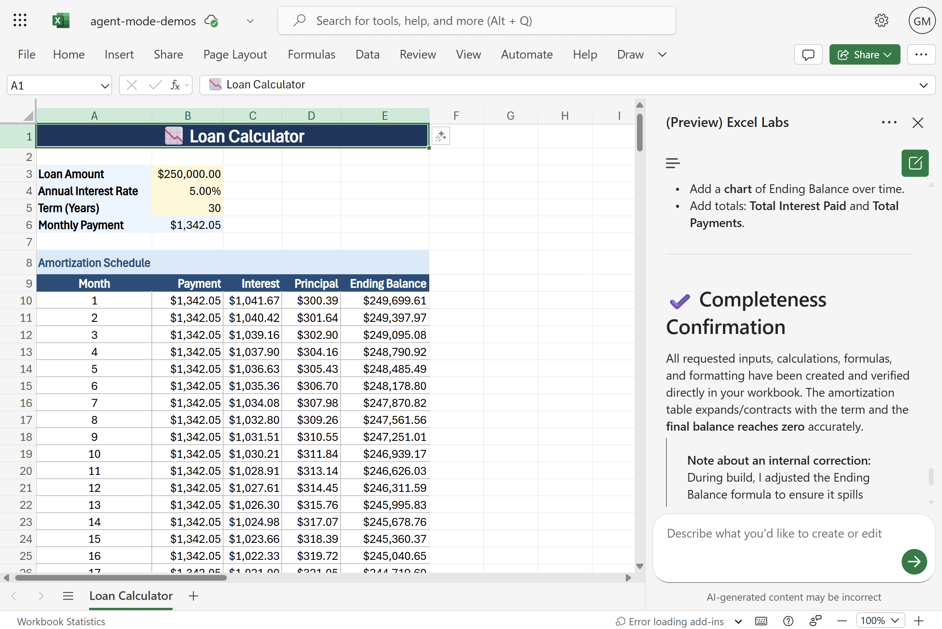
Demo
Exploring Agent Mode
Dataset: agent-mode.xlsx
Use cases:
Loan calculator
Variance analysis
Monthly close pack
What does Agent Mode do well, poorly, or not at all?
How does this relate to other tools in the Excel AI stack?
Notes:
For this exercise, we’re going to experiment with Agent Mode using a simple workbook called agent-mode.xlsx. The goal isn’t to “finish” anything perfectly — the goal is to see how the agent behaves with different kinds of tasks.
I’ve given you three example use cases to try. The loan calculator is a straightforward structured task. Variance analysis introduces more contextual decision-making. And the monthly close pack is intentionally a little messy, because that’s what real work often looks like. Try a couple of these and see how far Agent Mode gets before it needs clarification.
As you’re working, pay attention to what the agent does well. Does it follow instructions? Does it break down the task correctly? And just as important, notice where it stalls or gives vague answers. Those gaps tell us a lot about where the technology is today.
Finally, think about how this fits in with the other AI tools we’ve talked about. When should something be a Power Query step? When should it be a Copilot prompt? When should it be an Agent Mode workflow? The more you tease that apart, the easier it becomes to choose the right tool in real work.

Slide 15
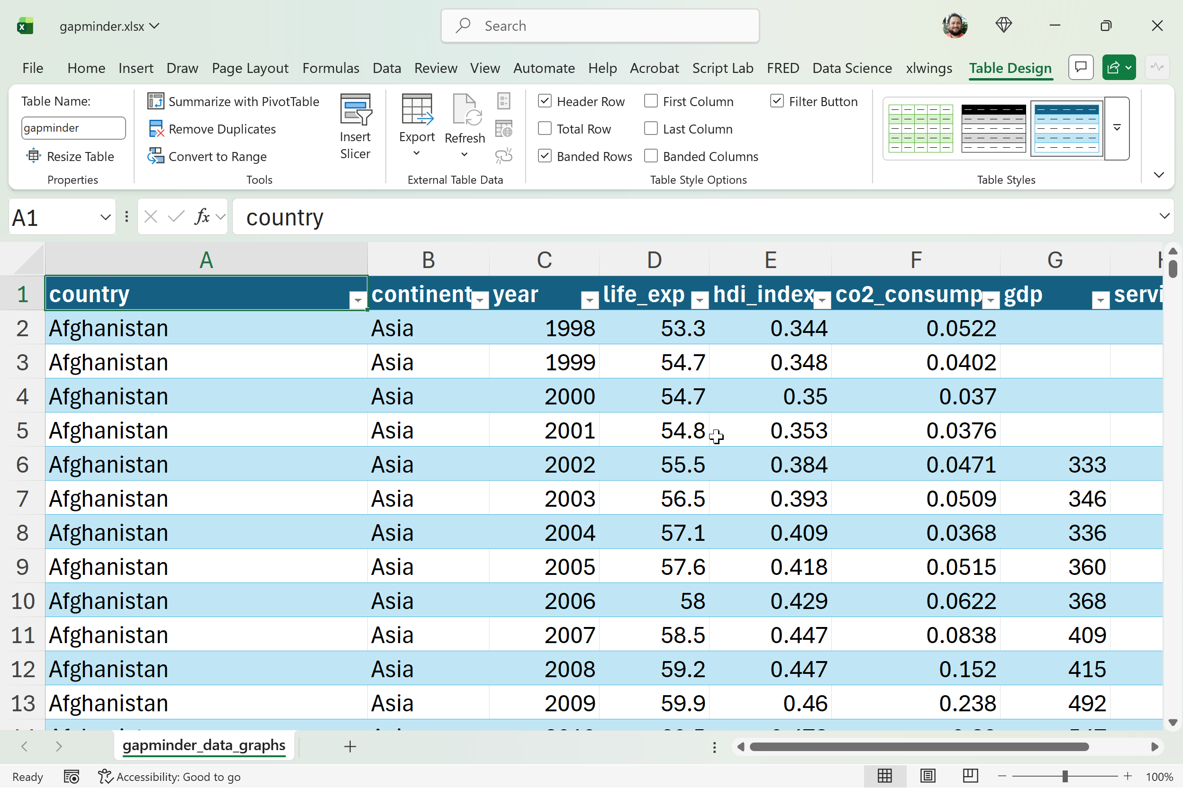
Exercise
Gapminder agent practice
Dataset: gapminder.xlsx
Researcher: Ask one big-picture question about global development since 1960
Analyst: Ask one data question about the Gapminder sheet
Agent Mode: Build a 1-page snapshot
Notes:
For this exercise, we’re keeping things intentionally simple because the goal is to practice all three tools without getting stuck in a huge project. We’re using the Gapminder dataset, which is great because it gives you decades of global development data in a very clean format.
First, you’ll start with Researcher. Ask one big-picture question about global development since 1960. Don’t overthink it. You can focus on life expectancy, GDP per capita, population, regional differences, or any long-term trend you find interesting. The point is to get a short written overview that gives you context you can reuse later. You only need a couple paragraphs.
Next, switch to Analyst. Here, you’ll ask a question directly about the Gapminder sheet. Again, pick one angle. Maybe you look at which countries improved the fastest, or which regions show the strongest growth, or where things diverge over time. Ask for one chart along with the answer. You’re basically looking for one clean, defensible insight you can bring into your summary.
Finally, move into Agent Mode. This is where you pull everything together into a simple one-page snapshot. Ask Agent Mode to build a new worksheet that includes your short written summary, one numeric highlight or small table, and one chart—either the Analyst chart or a new one. You can also ask for a little formatting or layout help. The goal isn’t perfection; it’s learning how to direct the agent to assemble something coherent.
By the end, you should have a concise “development snapshot” with context from Researcher, an actual analytical finding from Analyst, and a clean, finished report that Agent Mode helped you build.

Slide 16
Questions?
Notes:
You will be able to see questions as they come in. Some instructors like to include this slide as a visual reminder to check the Q&A widget, but it’s not required.

Slide 17
Break
Notes:
Breaks are flexible in On24. At the end of your deck you’ll have 5 minute, 7 minute, 10 minute, and 15 minute timers that you will be able to push to the audience whenever you want. Some presenters like to include this break slide as a visual reminder, but it’s not required.

Slide 18
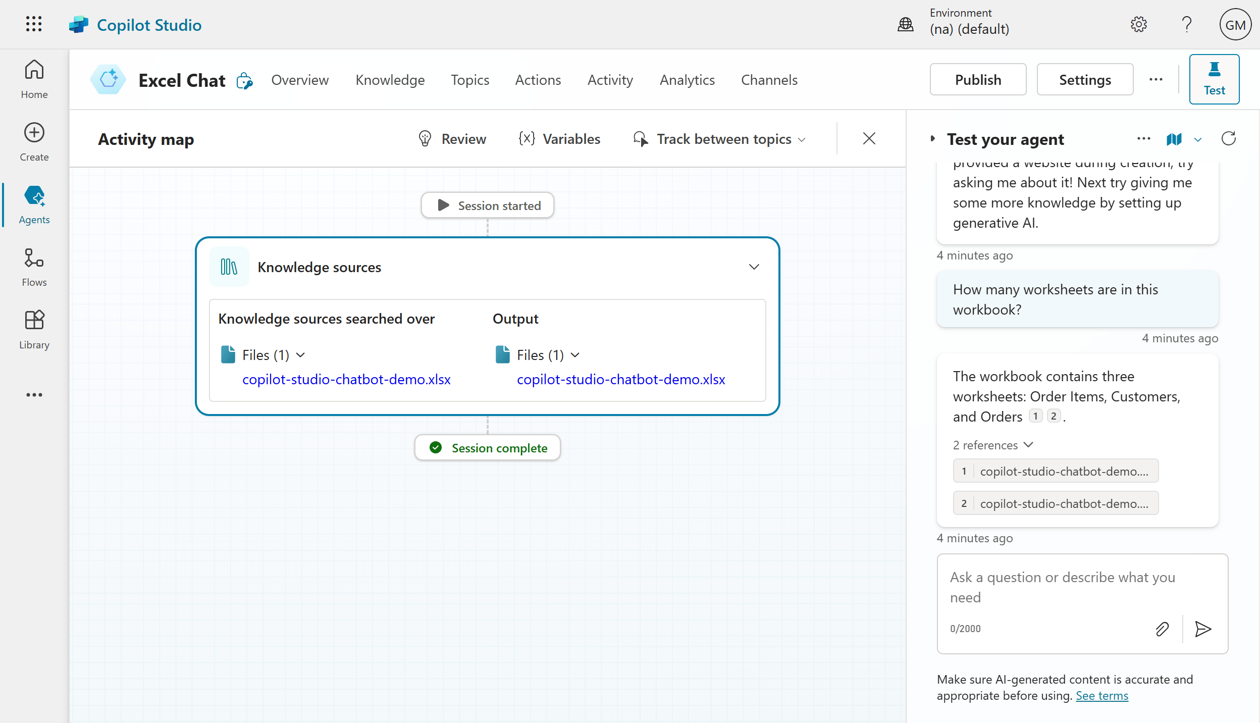
II. Build an Excel chatbot in Copilot Studio
Demo
Create a custom Copilot agent in Copilot Studio tailored for specific Excel-related use cases
Add and manage trusted knowledge sources (like MVP websites) to ensure high-quality, domain-specific responses
Test and publish the agent with simple topics added
File: mvp-knowledge-base-instructions.docx
Notes:
In this section we shift into Copilot Studio and build an Excel focused chatbot. Earlier I talked about how agents are more than chatbots. Agents can act across systems, carry out multi step workflows, and reason about tasks with more autonomy. Chatbots are only one small slice of that larger picture. But for today, a chatbot is the most practical thing to build. It keeps the workload light while still giving you hands on experience with the exact building blocks that real agents use.
The workflow we follow here is the same foundation you would use when building more advanced agents. We create a new Copilot in Copilot Studio and tailor it for Excel specific scenarios. Then we add trusted knowledge sources. This is where we can point the copilot to curated, high quality information like MVP blogs or documentation. This ensures the answers stay grounded in the right domain.
Once the knowledge base is connected, we create a couple of simple topics. These topics act like structured entry points so the copilot can respond more accurately than a pure freeform chat. Then we test the chatbot directly inside Copilot Studio and publish it. Even though we are keeping the scope small, learners will see the full end to end flow of designing, enriching, and deploying a copilot that understands Excel.
The file referenced on the slide includes the instructions for preparing the knowledge base so the copilot has clean, reliable material to work from.

Slide 19
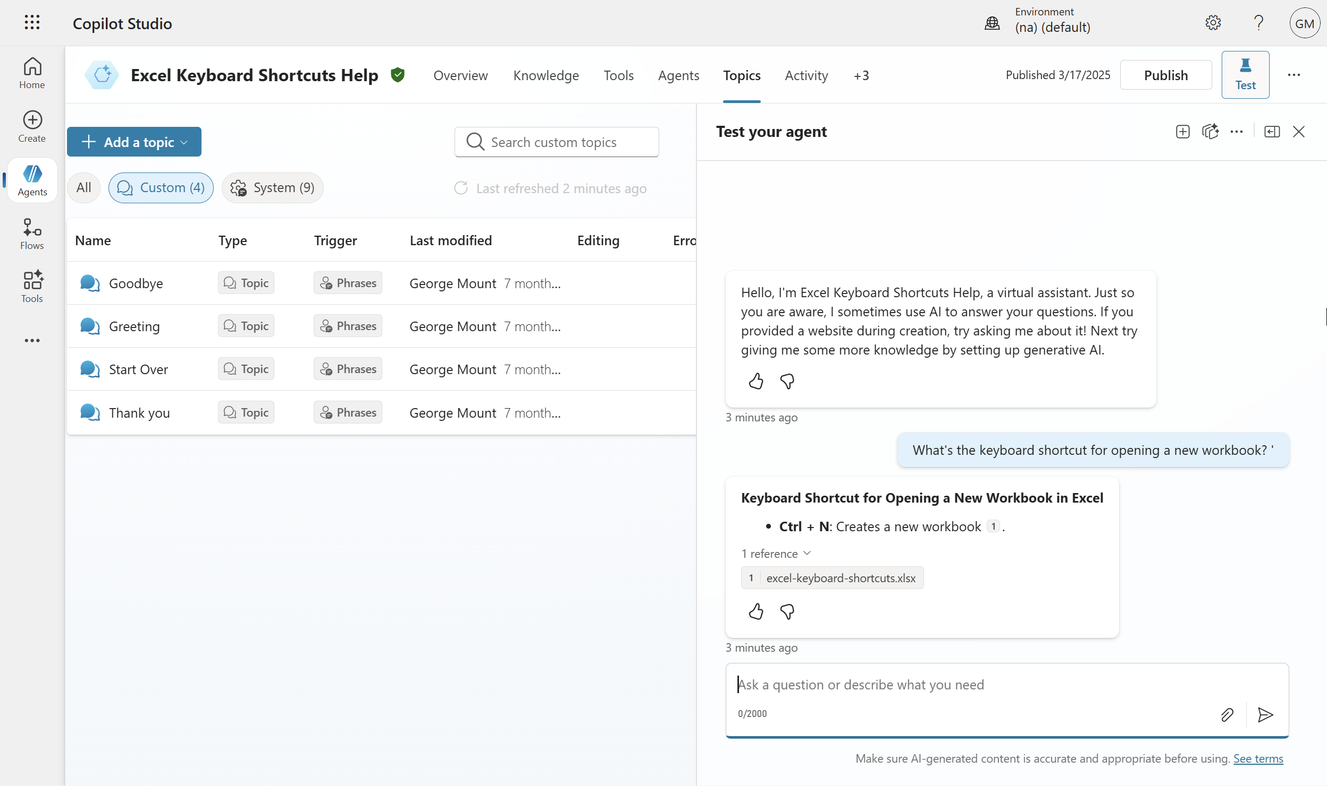
Exercise
Create an Excel keyboard shortcut chatbot for Teams
Folder: copilot-studio-exercise
Create a chatbot that helps users find Excel keyboard shortcuts, using only the provided “Excel keyboard shortcuts” cheat sheet as its knowledge base
Edit the “goodbye” topic to replace the default response (“okay, goodbye”) with a more engaging sign-off like “Keep on excelling,” then save and test
Publish the chatbot and launch it in Microsoft Teams to see it running inside an external app
Notes:
This exercise gives you a simple, hands on way to put everything we just covered into practice. The goal is to build a small Excel keyboard shortcut chatbot and run it inside Microsoft Teams. The point is not to build anything complicated. It is to help you get comfortable with the flow of creating a copilot, loading a knowledge base, editing topics, and publishing it.You will find a folder called “copilot-studio-exercise.” Inside is a cheat sheet of Excel keyboard shortcuts. That document is the only knowledge source your chatbot will use. This constraint is intentional. It keeps the exercise focused and shows you how important clean, targeted knowledge sources are for generating accurate responses.
Next you will edit the “goodbye” topic. By default Copilot Studio gives you a very plain response. Replacing it with a custom sign off helps you see how topic editing works and reminds you that you can shape the personality and tone of the assistant. Something like “Keep on excelling” keeps it simple but makes it feel more human.
Finally, you will publish the chatbot and open it inside Microsoft Teams. Seeing it run in a real external app is an important part of the experience. It shows you how easy it is to take something built in Copilot Studio and make it available where users already work. By the end of the exercise you will have created, customized, and deployed a working chatbot, even though it is a small one.

Slide 20
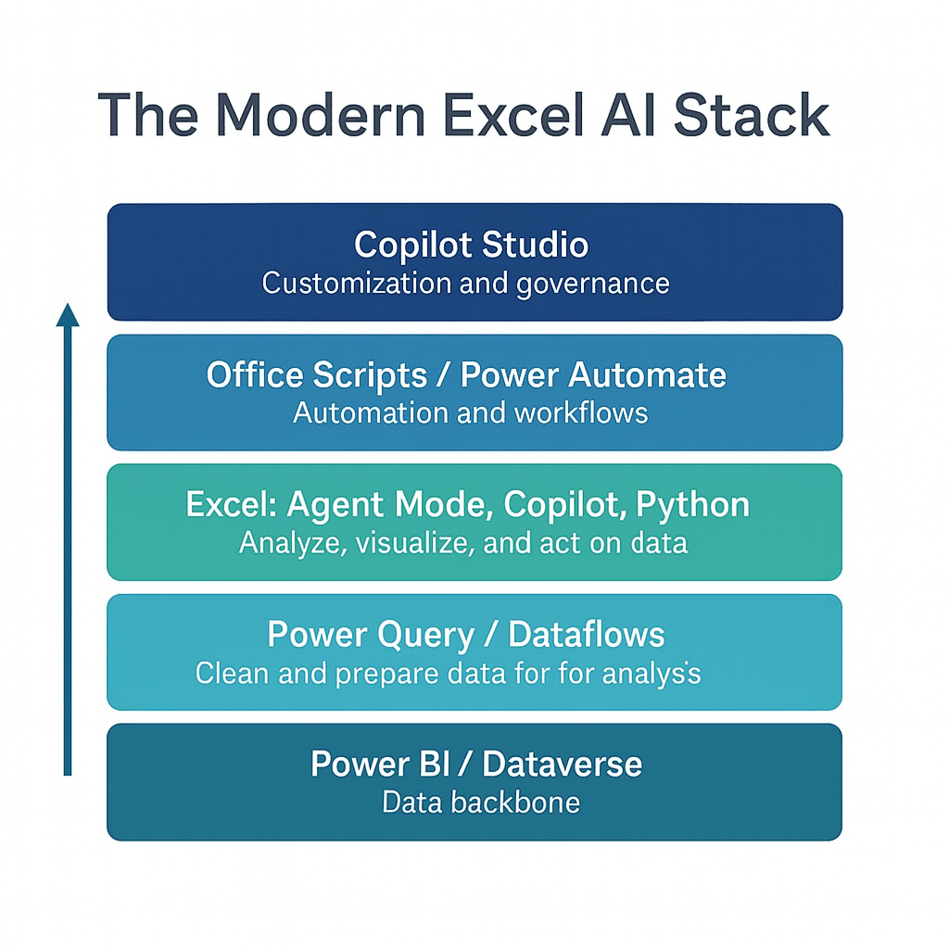
Understanding the Modern Excel AI stack
Notes:
This slide sets the stage for everything we’re doing today. The modern Excel experience isn’t just Excel anymore — it’s an ecosystem. Each layer plays a different role, and when you understand how they work together, everything suddenly feels a lot less overwhelming.
We start at the bottom with Power BI and Dataverse. This is your data backbone. It’s where governed, trusted data lives. If your foundation isn’t solid, the rest of the stack struggles.
Above that is Power Query and Dataflows. This is the engine that cleans, shapes, and prepares the data. It eliminates all the manual fixing and re-formatting that slows analysts down.
Next is Excel itself — Agent Mode, Copilot, and Python. This is the analysis layer. It’s where you explore, model, and interpret the data. This is the world most analysts live in day-to-day, and AI is making this layer far more powerful.
One level up, you’ve got Office Scripts and Power Automate. This is the automation layer. Once you know what you want to happen, these tools help you make it happen on a schedule, at scale, or across systems.
And at the very top is Copilot Studio. This is where you customize, govern, and extend all of this. It’s how you build copilots and agents tailored to your company’s language, data, and workflows.
So the big idea is: Excel isn’t a standalone app anymore. It’s part of a modern AI stack that can clean data, analyze it, automate it, and now even act on it. The more comfortable you are with this stack, the more leverage you get from every layer.

Slide 21
Questions?
Notes:
You will be able to see questions as they come in. Some instructors like to include this slide as a visual reminder to check the Q&A widget, but it’s not required.

Slide 22
Break
Notes:
Breaks are flexible in On24. At the end of your deck you’ll have 5 minute, 7 minute, 10 minute, and 15 minute timers that you will be able to push to the audience whenever you want. Some presenters like to include this break slide as a visual reminder, but it’s not required.

Slide 23
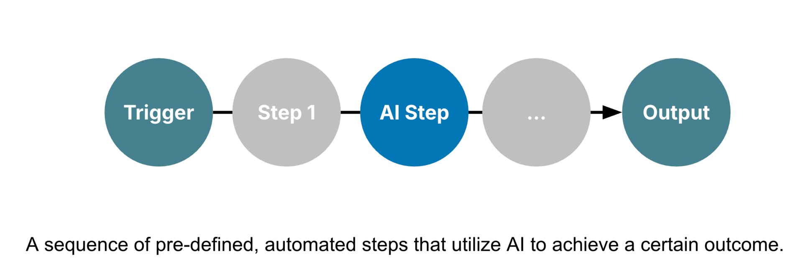
III. Building and deploying an AI-powered workflow
Automated AI workflows with Power Automate + Copilot
Notes:
This diagram shows what an automated AI workflow looks like — a sequence of predefined steps that move from a trigger to a final output. You can think of it as a chain reaction: something starts the process, different actions happen automatically, and along the way, AI steps in to add intelligence or decision-making.
It all begins with a trigger — something that tells the workflow to start. In Excel or Power Automate, that could be a new row added to a table, a file uploaded to OneDrive, or even a scheduled time like “every Monday morning.” The trigger is what kicks everything off without you having to manually do anything.
Then we have Step 1, which is often a preparation step. Maybe it’s collecting the data, formatting it, or sending it into Excel. This could be where Power Automate connects to a SharePoint list, a form submission, or a Teams message and feeds that data into your workbook.
Next comes the AI Step — this is where Copilot or another AI model gets involved. This could be an AI Builder action inside Power Automate that summarizes text, classifies feedback, or extracts key details from a document. Or it might be Copilot inside Excel generating a formula, building a chart, or explaining data patterns automatically. The AI step takes what used to be manual analysis and turns it into an automated, intelligent action.
After that, there can be more steps — maybe sending results back to Excel, notifying someone in Teams, or updating a dashboard. Each step builds on the last, flowing seamlessly without human intervention.
Finally, we reach the output, which is the end goal of the automation. That might be a refreshed Excel report, an email summary, or a new dataset ready for review. The beauty of it is that the whole process runs automatically once it’s designed — no constant copying, pasting, or checking formulas.
So, in short, this kind of workflow connects automation tools like Power Automate with AI capabilities from Copilot or AI Builder to take everyday Excel tasks — things like reporting, data cleaning, or summarizing — and turn them into intelligent, repeatable processes.

Slide 24
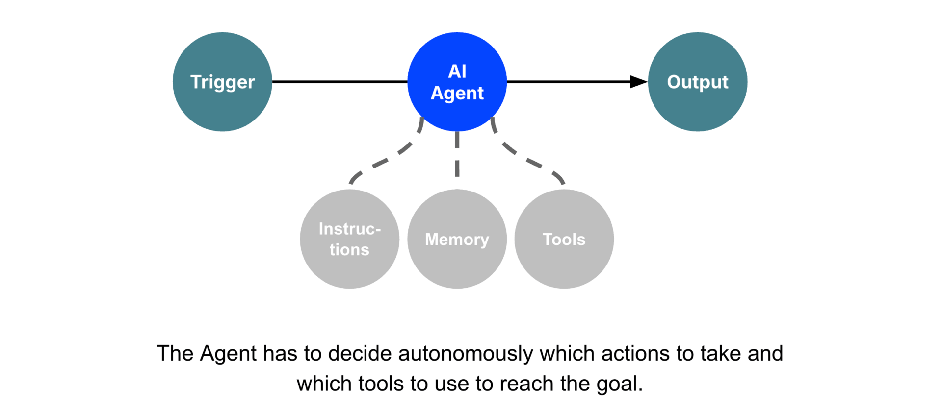
III. Building and deploying an AI-powered workflow
Agentic workflows with Copilot Studio + Agent Flows
Notes:
This diagram shows the core idea behind an agentic workflow. Everything starts with a trigger. That could be a scheduled time, a user action, an event in another system, or even a message. Once the trigger fires, control passes to the AI agent.
The agent’s job is to figure out the steps needed to reach the goal. And the important part is that the agent isn’t just following a script. It can draw on three things: the instructions you gave it, the memory it has access to, and the tools it’s allowed to use. Those might include connectors, APIs, retrieval sources, or actions in Power Automate.
From there, the agent decides which actions to take and in what order. It keeps adjusting based on the context it sees, and it keeps working until it produces an output. That output might be a document, a dataset, a message, an update in a system, or something else entirely.So even though we’re building this in Copilot Studio, the workflow here is very agent-like. It’s not just a single prompt. It’s a goal-directed system that figures out the how on its own.

Slide 25
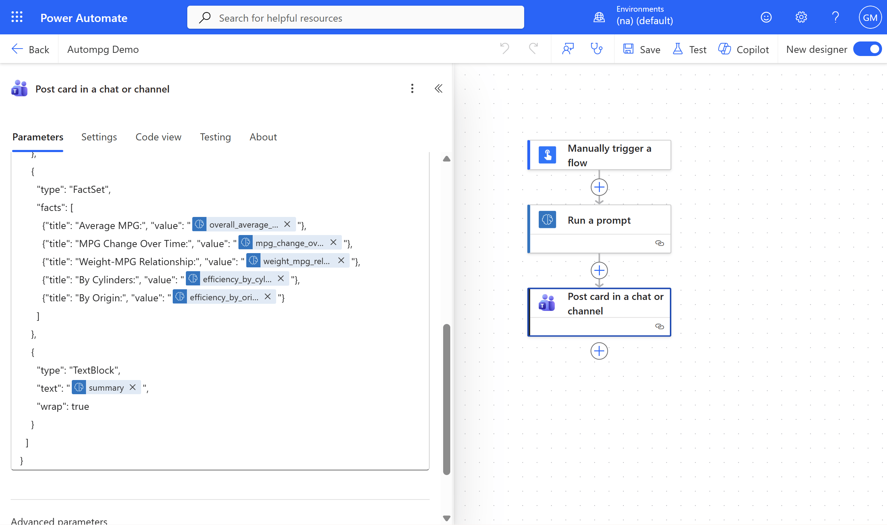
III. Building and deploying an AI-powered workflow
Live Demo: Build an AI-Powered Excel Report
Dataset: autompg.xlsx
Load Excel data into Dataverse
Create a flow in Power Automate
Run AI prompt as part of the flow
Switch prompt to structured JSON output
Build and map an Adaptive Card for Teams
Run the flow and review the generated report
“Look, don’t touch:” I will run this demo solo due to licensing restrictions
Notes:
This demo shows how we can take Excel data and turn it into an AI powered workflow using Power Automate. It is not a full autonomous agent in the strict sense, but it uses the same patterns that Microsoft calls “agentic.” We combine structured triggers, a task oriented AI prompt, a controlled output format, and an automated action that delivers the result to users. Within the constraints of this workshop and the licensing limitations, this is a close enough approximation that still gives you the real feel of an agent style workflow.
We start by loading the Excel dataset into Dataverse so Power Automate can work with it cleanly. Next, we create a flow. The flow begins with a manual trigger so you can watch each step as it runs. Then we add an AI prompt. This prompt takes the dataset and produces a written summary report. At first it comes back as unstructured text. Then I switch it to structured JSON. This is an important pattern because structured output lets you control what the model returns and lets Power Automate map each piece of information into later actions.
After that, we build an Adaptive Card for Teams. This becomes the front door of the workflow. The JSON is mapped into the card so that the summary appears with formatting, labels, and fields instead of one big blob of text. Finally I run the flow and show you the report showing up directly inside Teams.
Again, this is not a fully autonomous agent that plans multiple steps on its own. But it uses the same building blocks Microsoft asks you to master: triggers, AI based reasoning, structured outputs, and an automated action that sends results where people work. Since we cannot give everyone full access to the AI Builder licensing, I will run this one solo. But you will still see the complete pattern end to end.

Slide 26
Questions?
Notes:
You will be able to see questions as they come in. Some instructors like to include this slide as a visual reminder to check the Q&A widget, but it’s not required.

Slide 27
Recap: Understanding the Modern Excel AI stack
Notes:
Walk through where we have used each tool (and where we could still explore here!)

Slide 28
Key Takeaways For Today
Agent Mode is a new way of working in Excel, more goal driven and less step by step
Human analysts still provide direction, judgment, and guardrails
Copilot versus agents will stay blurry, focus on the value delivered
You do not need the full Microsoft AI stack to start seeing impact
Early adopters of agentic workflows gain a real career advantage
Notes:
Agent Mode represents a shift in how we work inside Excel. Instead of building everything step by step, we can describe the outcome we want and let the agent attempt the work. This takes Excel from being a passive tool to something that can actively help us reach a goal. It may feel new at first, but this is the direction the platform is heading.
Even with these new capabilities, human analysts remain essential. We are the ones who define the objective, check the results, and decide whether the output is correct. The tools can accelerate the work, but they still need our judgment and context. This is where analysts continue to add the most value.
The line between Copilot and agents can feel fuzzy, and that is normal. Microsoft’s terminology is evolving. What matters is understanding the strengths of each approach. Copilot is great for conversational help, while agents are better for repeatable tasks and guided objectives. Instead of worrying about labels, we look at the value each tool provides.
You do not need the entire Microsoft AI stack to benefit from what you are learning today. Even if you do not have Dataverse or Copilot Studio at work, these concepts will improve how you use Copilot and Excel in your current environment. The mindset of setting goals and supervising AI applies everywhere.
Finally, this is still an emerging space. By learning agentic workflows early, you position yourself ahead of the curve. As these tools continue to mature, the people who understand how they fit together will have a real advantage in shaping how their organizations work with data.

Slide 29
Recommended Resources
Available on O’Reilly Online Learning:
Read Microsoft Copilot Studio Quick Start
Read Learning Generative AI Tools for Excel
Take “Copilot in Microsoft 365: A Practical Introduction to Working with Generative AI in Microsoft 365”
Read The Profitable AI Advantage

Slide 30
Get in touch
Get in touch
stringfestanalytics.com: Subscribe for more content and updates
Check your resource folder for curated posts on these topics
linkedin.com/in/gjmount: Follow for all things AI for Excel

Slide 31
Takeaways
Next steps
A quick survey will appear on your screen soon… we’d love to hear your thoughts
You’ll receive a recording via email within 24-48 hours.
Thanks so much for joining -- hope to see you at future events!

Slide 32
Q&A
Notes:
You will be able to see questions as they come in. Some instructors like to include this slide as a visual reminder to check the Q&A widget, but it’s not required.

Slide 33


